Slide 1
Chapter 16
How to use CSS3 transitions, transforms, animations, and filters

Slide 2
Objectives
Applied
Use any of the properties presented in this chapter for working with transitions, transforms, animations, and filters.
Knowledge
Explain how a transition affects the way that a change is applied to an element.
Explain what a timing function is and how it affects a transition or animation.
Explain how the rotate, scale, skew, and translate transforms along with the transform origin effect an element.
Describe the function of the @keyframes selector rule for an animation and two ways it can be coded.
Describe what you can do with filters and when they’re applied.

Slide 3
Properties for working with transitions
transition
transition-property
transition-duration
transition-timing-function
transition-delay
The syntax for the shorthand transition property
transition: [property] [duration] [timing-function]
[delay];

Slide 4
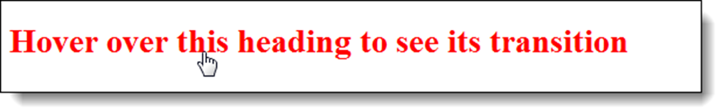
A transition that occurs when the mouse hovers over a heading
Before the transition
During the transition

Slide 5
The HTML for the element that will be transitioned
<h1>Hover over this heading to see its transition</h1>
The CSS for this two-property transition
h1 { font-size: 120%;
color: blue;
transition: font-size 2s ease-out 1s,
color 2s ease-in 1s; }
h1:hover {
cursor: pointer;
font-size: 180%;
color: red; }

Slide 6
A transition for one property
h1 { font-size: 120%;
transition: font-size 2s ease-out;
-webkit-transition: font-size 2s ease-out; }
h1:hover { font-size: 180%; }
A transition for all properties
transition: all 2s ease-out 1s

Slide 7
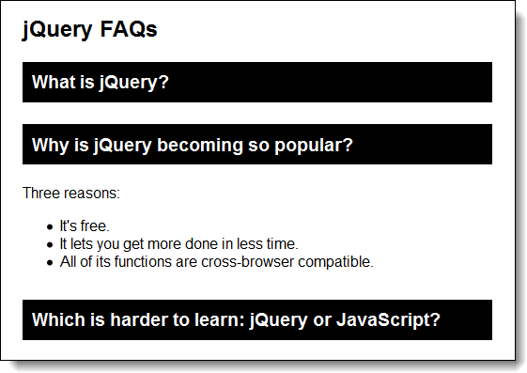
An accordion created with CSS3 transitions

Slide 8
The HTML for the accordion
<h1>jQuery FAQs</h1>
<div id="accordion">
<h3><a href="#Q1">What is jQuery?</a></h3>
<div id="Q1">Contents for first panel</div>
<h3><a href="#Q2">Why is jQuery becoming so
popular?</a></h3>
<div id="Q2">Contents for second panel</div>
<h3><a href="#Q3">Which is harder to learn:
...?</a></h3>
<div id="Q3">Contents for third panel</div>
</div>
The CSS for the transitions
#accordion div {
overflow: hidden;
height: 0;
transition: height 2s ease-in-out;
-webkit-transition: height 2s ease-in-out;
}
#accordion div:target { height: 120px; }

Slide 9
Properties for working with 2D transforms
transform, transform-origin
Methods for 2D transforms
rotate(angle)
rotateX(angle)
rotateY(angle)
scaleX(value)
scaleY(value)
scale(x-value,y-value)
skewX(angle)
skewY(angle)
skew(x-angle,y-angle)
translateX(value)
translateY(value)
translate(x-value,y-value)
matrix(a,b,c,d,e,f)

Slide 10
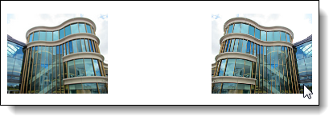
An image with a right origin that’s rotated right

Slide 11
The HTML for the original and rotated images
<p><img src="images/01.jpg" >
<img src="images/01.jpg" class="image1">
</p>
The CSS for the transform
.image1 {
transition: 2s; }
.image1:hover {
transform: rotateY(180deg);
transform-origin: right; }

Slide 12
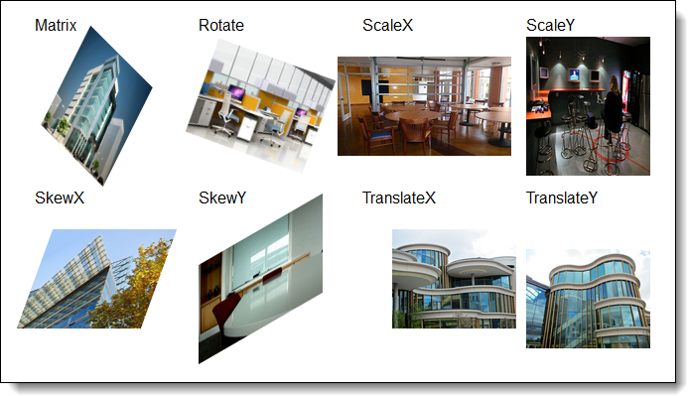
Images with 8 different transforms applied

Slide 13
The HTML for the images with transforms
<ul>
<li><p>Matrix</p>
<img src="images/01.jpg" class="image1"></li>
<li><p>Rotate</p>
<img src="images/02.jpg" class="image2"></li>
<li><p>ScaleX</p>
<img src="images/03.jpg" class="image3"></li>
<li><p>ScaleY</p>
<img src="images/04.jpg" class="image4"></li>
<li><p>SkewX</p>
<img src="images/05.jpg" class="image5"></li>
<li><p>SkewY</p>
<img src="images/06.jpg" class="image6"></li>
<li><p>TranslateX</p>
<img src="images/07.jpg" class="image7"></li>
<li><p>TranslateY</p>
<img src="images/08.jpg" class="image8"></li>
</ul>

Slide 14
The CSS for the 2D transforms
.image1 {transform: matrix(0.5,0.5,-0.5,1,0,0);}
.image2 {transform: rotate(20deg);}
.image3 {transform: scaleX(1.4);}
.image4 {transform: scaleY(1.4);}
.image5 {transform: skewX(-20deg);}
.image6 {transform: skewY(-30deg);}
.image7 {transform: translateX(30px);}
.image8 {transform: translateY(20px);}

Slide 15
Properties for working with animations
animation
animation-name
animation-duration
animation-delay
animation-iteration-count
animation-timing-function
animation-direction
The syntax for the shorthand animation property
animation: [name] [duration] [timing-function] [delay]
[iteration-count] [direction];

Slide 16


A simple animation that moves a heading and changes its color
Starting in blue with a left margin of 20%
Ending in red with a left margin of 60%

Slide 17
The HTML for the heading
<h1>This text will animate.</h1>
The CSS for the animation
h1 {animation: moveright 3s 2s infinite ease-in-out
alternate; }
@keyframes moveright {
from { margin-left: 20%;
color: blue; }
to { margin-left: 60%;
color: red; }
}

Slide 18
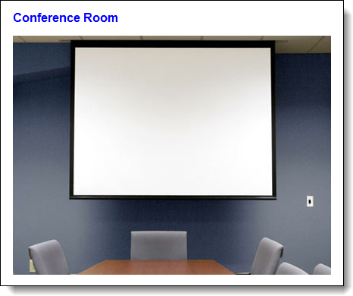
A slide show animation with captions

Slide 19
The HTML for an unordered list that contains the images and captions
<ul>
<li>
<h2>Front of Building</h2>
<img src="images/01.jpg" alt="">
</li>
...
</ul>
The CSS for the ul and li elements
ul { list-style: none;
width: 500%;
position: relative; }
ul li { width: 20%;
float: left; }

Slide 20
The CSS for the animation
ul { animation: slideshow 15s infinite alternate; }
@keyframes slideshow {
0% {left: 0%;}
10% {left: 0%;}
20% {left: -100%;}
30% {left: -100%;}
40% {left: -200%;}
50% {left: -200%;}
60% {left: -300%;}
70% {left: -300%;}
80% {left: -400%;}
90% {left: -400%;}
100% {left: -400%;}
}

Slide 21
The syntax for adding a filter to an element
filter: filtermethod(value);
The filter methods
blur(value)
brightness(value)
contrast(value)
drop-shadow(values)
grayscale(value)
hue-rotate(angle)
invert(value)
opacity(value)
saturate(value)
sepia(value)

Slide 22
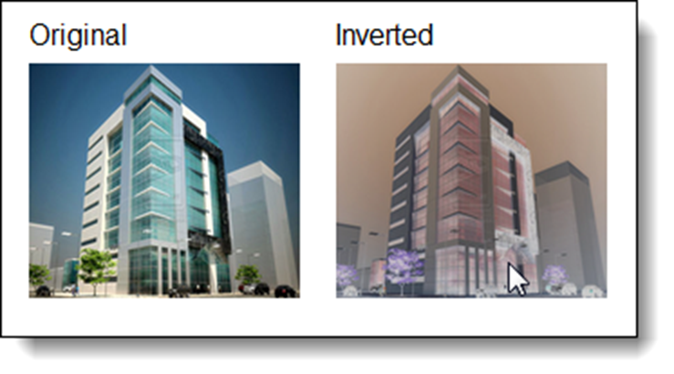
An image before and after its colors are inverted
The HTML for the images
<li>Original<br><img src="images/01.jpg" alt=""></li>
<li>Inverted<br><img src="images/01.jpg" class="image1"
alt=""></li>
The CSS for the filter
.image1:hover { filter: invert(.80); }

Slide 23
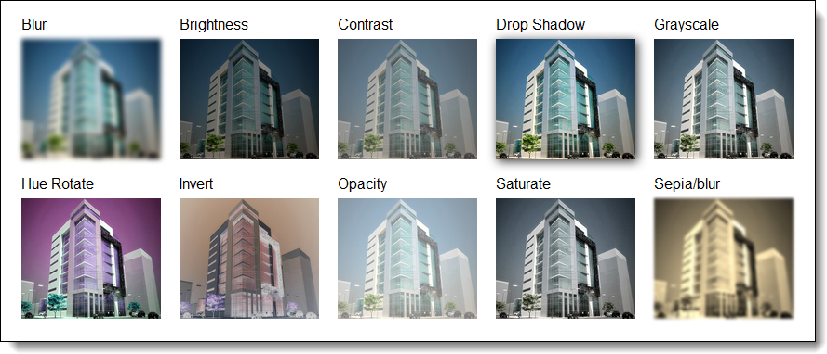
Different filters applied to an image in Chrome

Slide 24
The HTML for the images
<ul>
<li>Blur<br> <img src="images/01.jpg" class="image1"
alt=""></li>
<li>Brightness<br> <img src="images/01.jpg" class="image2"
alt=""></li>
<li>Contrast<br> <img src="images/01.jpg" class="image3"
alt=""></li>
<li>Drop Shadow<br> <img src="images/01.jpg" class="image4"
alt=""></li>
<li>Grayscale<br> <img src="images/01.jpg" class="image5"
alt=""></li>
<li>Hue Rotate<br> <img src="images/01.jpg" class="image6"
alt=""></li>
<li>Invert<br> <img src="images/01.jpg" class="image7"
alt=""></li>
<li>Opacity<br> <img src="images/01.jpg" class="image8"
alt=""></li>
<li>Saturate<br> <img src="images/01.jpg" class="image9"
alt=""></li>
<li>Sepia/blur<br> <img src="images/01.jpg" class="image10"
alt=""></li>
</ul>

Slide 25
The CSS for the filters
.image1 { filter: blur(2px); }
.image2 { filter: brightness(50%); }
.image3 { filter: contrast(50%);}
.image4 { filter: drop-shadow(2px 2px 5px #333); }
.image5 { filter: grayscale(50%); }
.image6 { filter: hue-rotate(90deg); }
.image7 { filter: invert(.8); }
.image8 { filter: opacity(.50); }
.image9 { filter: saturate(30%); }
.image10{ filter: sepia(100%) blur(1px); }

Slide 26
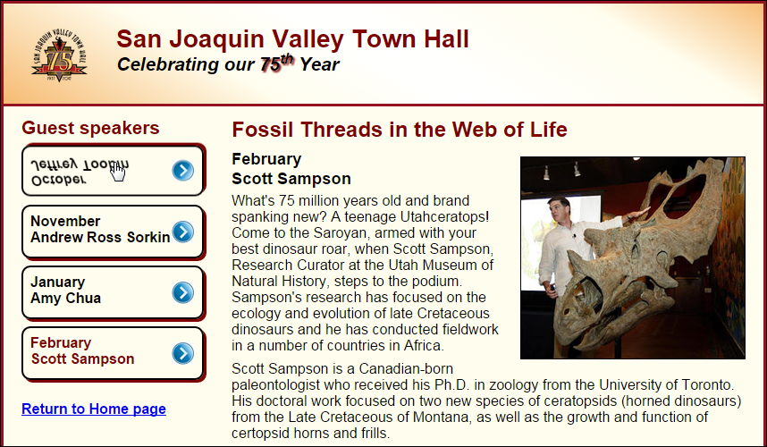
Short 16-1 Use a CSS3 transition and transform

Slide 27
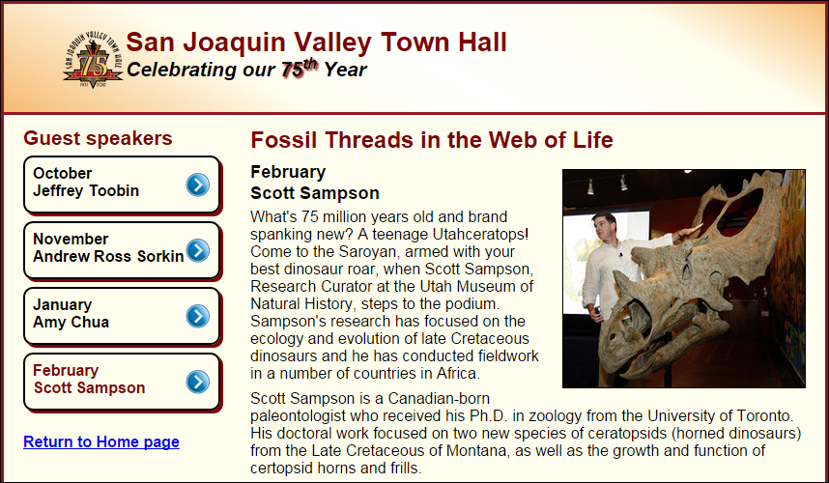
Short 16-2 Use CSS3 animation

